Slide 1


Green Pace
Security Policy Presentation
Developer: Elizabeth Wing
Notes:
Hello, my name is Elizabeth Wing, and today I will be presenting Green Pace's secure software development recommendations.
This presentation will cover the importance of secure coding standards, risk assessment, encryption, access controls, and automated security testing. I will also demonstrate how unit testing can help identify vulnerabilities before software is deployed.
The goal is to show how Green Pace can strengthen its development practices and reduce security risks throughout the software development lifecycle.

Slide 2

OVERVIEW: DEFENSE IN DEPTH
Green Pace uses layered security controls to protect applications and data, reducing risks if one defense fails.
Notes:
Defense in depth is an important part of Green Pace's security strategy because it uses multiple layers of protection rather than relying on a single security measure.
These layers include secure coding practices, input validation, encryption, access controls, and security testing. If one layer fails or is bypassed, the remaining protections can help prevent an attacker from compromising the entire system.
By incorporating defense in depth throughout software development, Green Pace can reduce vulnerabilities, protect sensitive information, and strengthen the overall security of its applications.

Slide 3
THREATS MATRIX
Likely STD-008-CPP (Level 4) Input Validation STD-004-CPP (Level 5) SQL Injection | Priority STD-003-CPP (Level 4) String Storage STD-005-CPP (Level 3) Memory Protection STD-006-CPP (Level 3) Assertions
Low priority STD-001-CPP (Level 2) Data Types STD-002-CPP (Level 3) Integer Ranges STD-010-CPP (Level 2) File Handling | Unlikely STD-007-CPP (Level 3) Exception Handling STD-009-CPP (Level 3) Resource Management
Risks are prioritized by severity, likelihood, and remediation cost.
Notes:
Green Pace uses a threat matrix to organize ten coding vulnerabilities based on their severity, likelihood, and remediation cost.
SQL injection is ranked at Level 5 because it can expose sensitive database information. Input validation and string storage issues are ranked at Level 4 because they can lead to security vulnerabilities when data is handled incorrectly.
Other risks include memory protection, exception handling, and resource management. These are also important, even when their likelihood is lower.
By identifying and prioritizing these threats, Green Pace can address the most serious vulnerabilities first and use automated security tools to detect potential problems earlier.

Slide 4
10 PRINCIPLES
Validate Input Data — STD-001, 002, 003, 004, 006, 007, 008
Heed Compiler Warnings — STD-001, 005, 006
Architect and Design for Security Policies — STD-008
Keep It Simple — STD-007, 009, 010
Default Deny — No direct mapping
Principle of Least Privilege — No direct mapping
Sanitize Data Sent to Other Systems — No direct mapping
Practice Defense in Depth — STD-002 through STD-010
Use Effective Quality Assurance Techniques — STD-002 through STD-010
Adopt a Secure Coding Standard — STD-003, 004, 005, 009, 010
Notes:
Green Pace's security policy is organized around ten guiding principles that help developers create safer software.
Each principle supports secure development practices and connects to the coding standards listed on this slide.
For example, validating input data supports standards involving data types, integer ranges, SQL injection prevention, and input validation.
The principle of defense in depth supports multiple standards because it encourages developers to use several layers of protection rather than relying on a single security measure.
Other principles, such as default deny and least privilege, guide access control decisions even when they do not directly map to one of the ten coding standards.
Together, these principles establish a consistent approach to secure software development.

Slide 5
CODING STANDARDS
Use Parameterized Queries for SQL Statements — Level 5
Guarantee Sufficient Storage for Strings — Level 4
Validate User Input Before Processing — Level 4
Verify Integer Values Are Within Range — Level 3
Validate Pointers Before Dereferencing — Level 3
Use Assertions to Detect Invalid Conditions — Level 3
Handle Exceptions Appropriately — Level 3
Release Dynamically Allocated Memory — Level 3
Use Appropriate Data Types — Level 2
Verify Files Open Successfully Before Use — Level 2
Vulnerabilities are ranked from 1–5 based on severity, likelihood, and remediation cost.
Notes:
Green Pace's secure development policy includes ten coding standards designed to reduce vulnerabilities in C++ applications.
These standards are organized by priority, with threat levels ranging from one to five based on severity, likelihood, and remediation cost.
SQL injection is ranked highest at Level 5 because it can allow attackers to access or manipulate sensitive database information. Using parameterized queries helps prevent this vulnerability.
String storage and input validation are ranked at Level 4 because improper handling of data can cause errors and create security risks.
The remaining standards address issues such as integer ranges, memory safety, exception handling, and file operations.
By following these standards, developers can identify potential security problems earlier and build more reliable applications.

Slide 6
ENCRYPTION POLICIES
Data at Rest — AES-256
Protects stored databases, files, and sensitive customer information.
Data in Transit — TLS 1.3
Protects information traveling between users, applications, and servers.
Data in Use — Secure Memory Protection
Protects sensitive information while applications process it.
Key Management
Restrict access to encryption keys and validate security certificates.
Notes:
Green Pace uses encryption to protect sensitive information while it is stored, transferred, and processed.
For data at rest, AES-256 helps protect stored databases and customer information. For example, if someone gains unauthorized access to stored files, encryption helps prevent them from reading the information without the proper key.
For data in transit, TLS 1.3 protects information traveling between users, applications, and servers.
For data in use, secure memory handling helps reduce the risk of exposing sensitive information while an application processes it.
Finally, proper key management and certificate validation are necessary to keep these protections effective. Together, these strategies help Green Pace protect sensitive information throughout its lifecycle.

Slide 7
TRIPLE-A POLICIES
Authentication
Verifies user identity through passwords and multi-factor authentication.
Authorization
Limits access based on user roles and permissions.
Accounting
Records user activity through audit logs to identify suspicious behavior.
Notes:
Green Pace uses the Triple-A framework to help protect its systems from unauthorized access.
Authentication verifies a user's identity. For example, employees may be required to enter a password and complete multi-factor authentication before accessing company systems.
Authorization determines what users are allowed to access. For example, developers should only have access to the files and systems necessary for their responsibilities.
Accounting records user activity through audit logs. These logs can help Green Pace identify suspicious behavior and investigate potential security incidents.
Together, these policies strengthen access controls, protect sensitive information, and support accountability.

Slide 8
Unit Testing
Input Validation
STD-008-CPP | GoogleTest
Positive: Accept valid inputs
Negative: Reject invalid inputs
Boundary: Verify input limits
Goal: Identify vulnerabilities before deployment.
Notes:
For my automated testing demonstration, I used GoogleTest in Visual Studio to test input validation in a C++ program.
The function accepts numbers between one and one hundred and rejects values outside that range.
I created four tests to check valid input, invalid input, and the minimum and maximum boundaries. All four tests passed successfully.
Automated unit testing helps developers identify coding errors earlier and verify that security controls behave as expected.
To expand this testing, I would add values just outside the boundaries, such as zero and one hundred and one, to confirm that both are rejected.

Slide 9
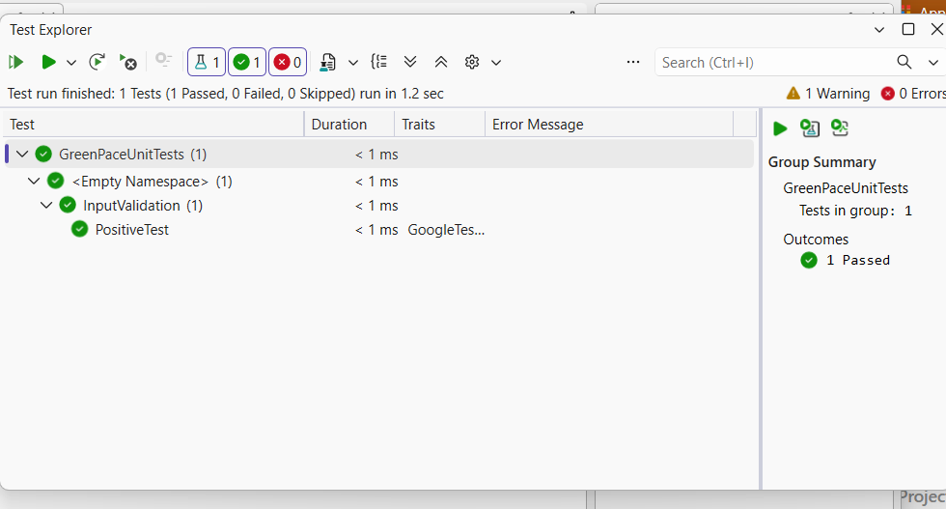
Unit Testing: Positive Test
Input: 25
Expected Result: Input accepted
Assertion: EXPECT_TRUE
Purpose: Verify valid input is accepted
Notes:
The first unit test checks whether the program correctly accepts a valid input.
For this test, I entered the number 25, which falls within the accepted range of one to one hundred.
Using GoogleTest, I verified that the input validation function returned true, meaning the input was accepted.
As shown in the screenshot, the test passed successfully. This confirms that the function correctly handles this valid input.

Slide 10
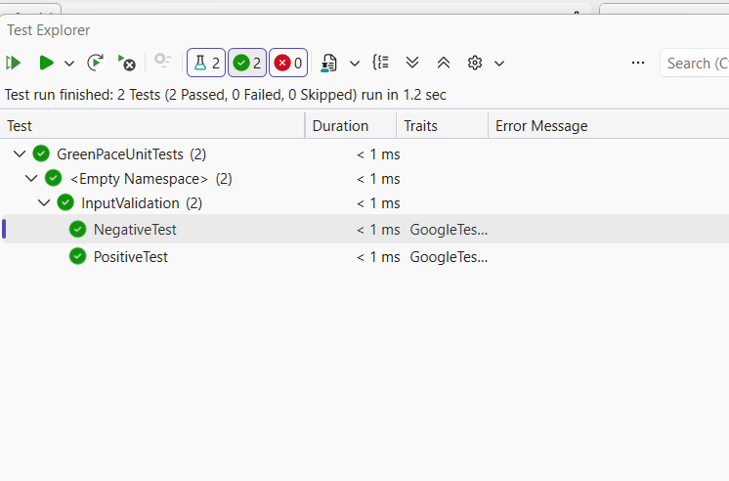
Unit Testing: Negative Test
Input: -5
Expected Result: Input rejected
Assertion: EXPECT_FALSE
Purpose: Verify invalid input is rejected
Notes:
The second unit test checks whether the program correctly rejects invalid input.
For this test, I entered negative five, which falls outside the accepted range of one to one hundred.
Using GoogleTest, I verified that the input validation function returned false, meaning the input was rejected.
As shown in the screenshot, the test passed successfully. This demonstrates that the function correctly handles this invalid input.

Slide 11
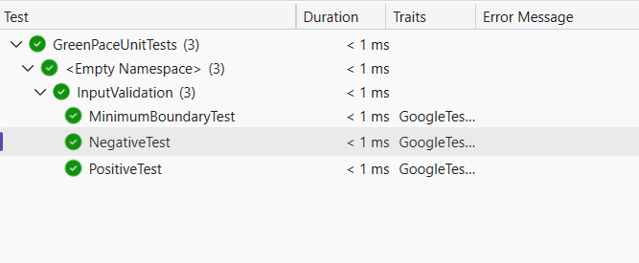
Unit Testing: Minimum Boundary Test
Input: 1
Expected Result: Input accepted
Assertion: EXPECT_TRUE
Purpose: Verify the minimum allowed value
Notes:
The third unit test checks the minimum boundary of the accepted input range.
For this test, I entered the number one, which is the lowest valid input the program allows.
Using GoogleTest, I verified that the input validation function returned true, meaning the value was accepted.
As shown in the screenshot, the test passed successfully. This confirms that the function correctly accepts the minimum allowed value.

Slide 12
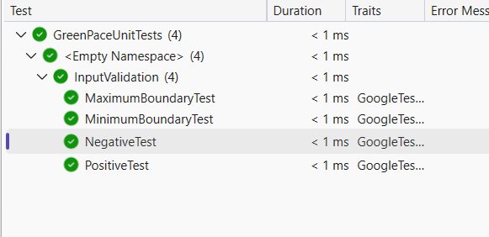
Unit Testing: Maximum Boundary
Input: 100
Expected Result: Input accepted
Assertion: EXPECT_TRUE
Purpose: Verify the maximum allowed value
Notes:
The fourth unit test checks the maximum boundary of the accepted input range.
For this test, I entered the number one hundred, which is the highest valid input the program allows.
Using GoogleTest, I verified that the input validation function returned true, meaning the value was accepted.
As shown in the screenshot, the test passed successfully. This confirms that the function correctly accepts the maximum allowed value.
Overall, all four unit tests passed with zero failures.

Slide 13

AUTOMATION SUMMARY
Notes:
Automation helps Green Pace incorporate security throughout the software development process instead of waiting until the end to identify problems.
During planning, developers identify security requirements and potential risks. During coding, automated tools can check for unsafe programming practices.
During building and testing, tools such as GoogleTest and static code analyzers help identify errors and vulnerabilities.
Finally, during deployment and monitoring, security checks continue to help protect applications after release.
This approach supports DevSecOps by making security a continuous responsibility throughout development.

Slide 14
TOOLS
  Planning and Coding — Apply secure coding standards and review security requirements.
  Build — GCC, Clang-Tidy, and Cppcheck identify coding vulnerabilities through static analysis.
  Testing — GoogleTest and sanitizers detect functional errors, memory issues, and unsafe inputs.
  Deployment and Monitoring — Automated security checks, audit logs, and alerts support ongoing protection.
Notes:
Green Pace can use automated security tools throughout the software development process.
During planning and coding, developers review security requirements and follow established coding standards.
During the build stage, GCC compiles the code, while Clang-Tidy and Cppcheck help identify unsafe coding practices through static analysis.
During testing, GoogleTest verifies that individual functions behave as expected, while sanitizers can detect memory-related errors.
Finally, automated security checks, audit logs, and alerts support deployment and ongoing monitoring.
Using these tools at different stages helps Green Pace identify potential vulnerabilities earlier and maintain security after software is released.

Slide 15
RISKS AND BENEFITS
Problem — Vulnerabilities can expose sensitive data and disrupt operations.
Solution — Integrate secure coding standards and automated testing into DevSecOps.
Benefits — Earlier detection, lower remediation costs, and stronger application security.
Risks — Implementation costs, false positives, and potential development delays.
Recommendation — Prioritize high-risk vulnerabilities and introduce automated checks throughout development.
Notes:
Green Pace must consider both the risks and benefits of implementing stronger security practices.
The biggest concern is that coding vulnerabilities could expose sensitive information or disrupt business operations.
I recommend addressing SQL injection first because it has the highest threat level in the security policy. Using parameterized queries and automated security checks can help reduce this risk.
Although implementing these protections requires time, training, and resources, identifying vulnerabilities early can lower remediation costs.
If Green Pace delays these improvements, vulnerabilities may remain undetected until they cause more serious problems.
Overall, the benefits of early detection, stronger security, and reduced long-term costs outweigh the initial challenges.

Slide 16
RECOMMENDATIONS
Enforce secure coding standards across development.
Integrate automated testing into the CI/CD pipeline.
Require code reviews and vulnerability scanning.
Provide ongoing developer security training.
Review and update security policies regularly.
Notes:
Moving forward, I recommend that Green Pace focus on making its security policies consistent and enforceable throughout development.
One potential gap is that having written coding standards does not guarantee developers will follow them. Requiring code reviews and automated security scans can help address this issue.
Another area for improvement is integrating automated testing into the continuous integration and deployment pipeline. This would allow security checks to run regularly as code changes are made.
I also recommend ongoing developer training and regular policy reviews to address emerging threats.
These improvements support the NIST Secure Software Development Framework, which recommends integrating security practices throughout the software development lifecycle.

Slide 17
CONCLUSIONS
Green Pace should adopt SEI CERT C++ coding standards, enforce input validation, and integrate automated security testing throughout development.
Combined with encryption, access controls, and defense in depth, these practices reduce vulnerabilities, protect sensitive information, and strengthen long-term software security.
Notes:
In conclusion, Green Pace should adopt SEI CERT C++ coding standards and make security a continuous part of software development.
The company should prioritize high-risk vulnerabilities, enforce input validation, and integrate automated security testing to identify problems before deployment.
Combining these practices with encryption, access controls, and defense in depth can help protect sensitive information and reduce security risks.
Moving forward, Green Pace should regularly review its policies, expand automated testing, and provide ongoing developer training as new threats emerge.
These recommendations align with the NIST Secure Software Development Framework and provide a foundation for maintaining secure, reliable software in the future.

Slide 18
REFERENCES
Google. (n.d.). GoogleTest primer. https://google.github.io/googletest/primer.html
LLVM Project. (n.d.). Clang-Tidy. https://clang.llvm.org/extra/clang-tidy/
Software Engineering Institute. (2017). SEI CERT C++ coding standard: Rules for developing safe, reliable, and secure systems (2016 edition). Carnegie Mellon University. https://www.sei.cmu.edu/library/sei-cert-c-coding-standard-rules-for-developing-safe-reliable-and-secure-systems-2016-edition-2/
Souppaya, M., Scarfone, K., & Dodson, D. (2022). Secure software development framework (SSDF) version 1.1: Recommendations for mitigating the risk of software vulnerabilities (NIST SP 800-218). National Institute of Standards and Technology. https://doi.org/10.6028/NIST.SP.800-218
Notes:
These are the references I used to support my research and recommendations throughout this presentation.
They include resources from the Software Engineering Institute, the National Institute of Standards and Technology, and documentation for the automated testing and code analysis tools discussed.
Thank you for taking the time to review my presentation.

